Slide 1
Week 3
Today’s Class:
Regression Trees – Decision Trees
Random Forests
Gradient Boosting Machine (GBM)
Clustering Techniques
Example code
Exercise

Slide 2

Decision Tree
DTs are used to to approximate discrete valued target functions
A series of if-else clauses are used to generate the learning function
Can be used for both classification and regression
Use Information Gain, Entropy, Gini Index to decide on which feature to decide on when building the tree
What is Entropy?
A measure of Uncertainty/ Randomness
Information Gain is the reduction in entropy/ randomness
Gini Index: It is the measure of inequality of distribution

Slide 3
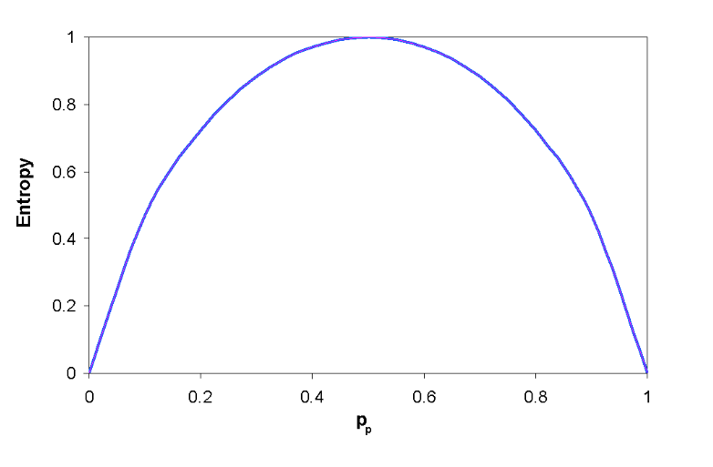
Entropy
Entropy is measured by the number of bits that is needed to explain an event and it’s highest when the chances are equi-probable
Coin toss example

Slide 4
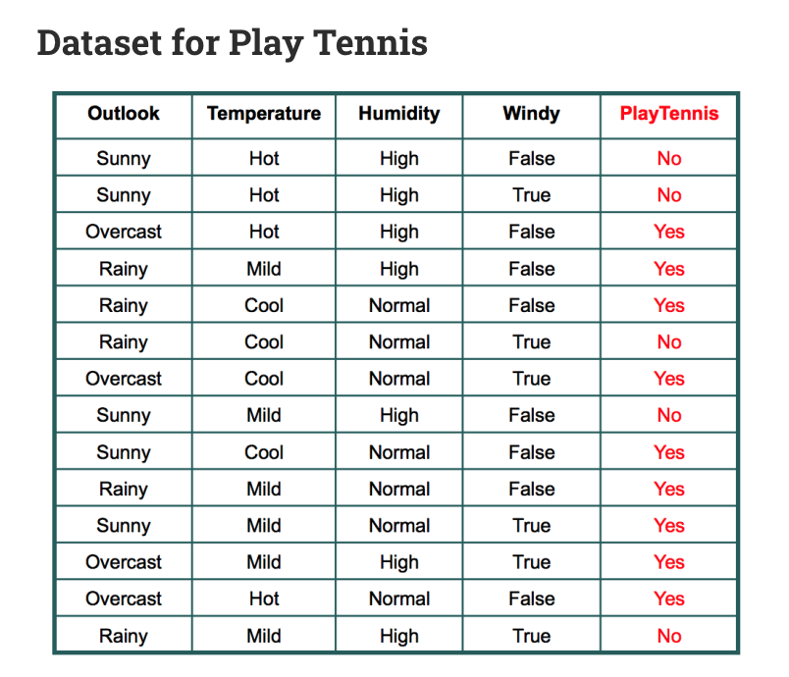
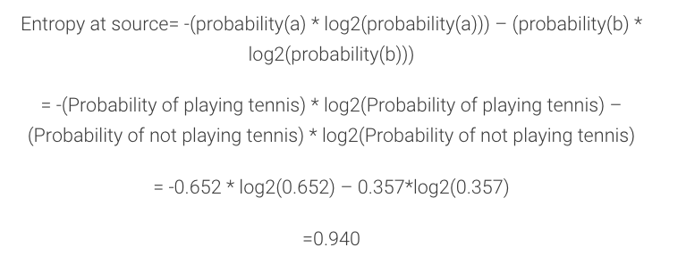
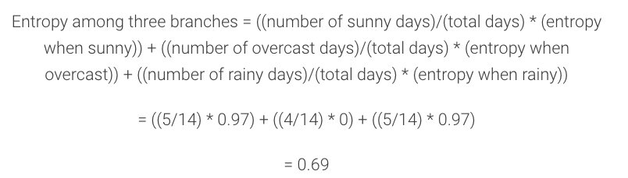
Now we calculate for each feature, the entropy among its’ levels:
Eg: For feature Outlook:
Information Gain = 0.94-0.69 = 0.246
Pick the feature with the highest IG sequentially

Slide 5
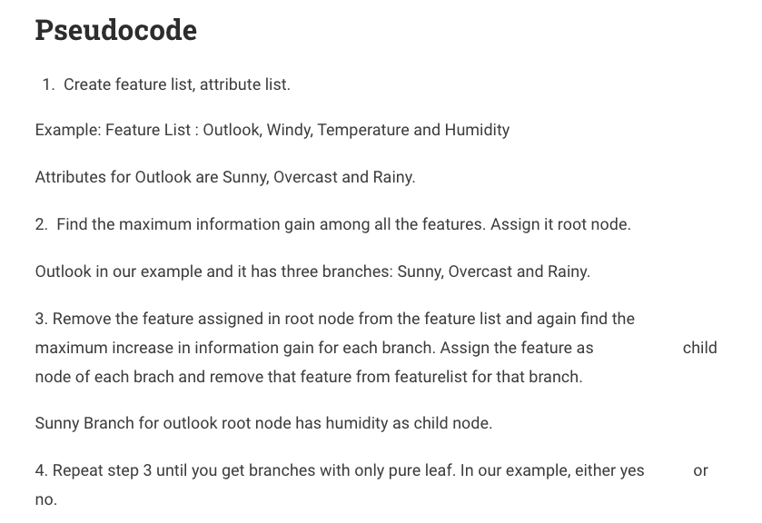

Slide 6
DECISION TREE MODELING
Pros:
Works well with categorical variables – no need for encoding (like one-hot encoding)
Detection of non-linear models
Handle missing values quite well – even if the missing values are not in the training set but in the testing set
Easy to visualize and interpret
Cons
Unstable – a small change in data cause the model to shift – outliers have a big impact
Attributes with more levels are favored when information-gain based split is performed – erroneous results
Prone to inaccuracy and over-fitting >> Random Foresting

Slide 7
Random Forest
Create a bootstrapped data from the original dataset – resampling and random
Randomly select 2 features and select the best feature based on IG for root (return the feature not selected back to the remaining features)
Randomly select 2 features from remaining features and do the earlier step
Continue to build the tree w. random subset of features
Repeat this process to create many DTs (100s)
Run a new sample over all the trees and use voting to find the best prediction
Use the “Out-of-bag dataset” to measure the accuracy of the RF
Tune accordingly

Slide 8
Random Forests Modeling
B(bootstrapping)agging(aggerating) method
Ensemble approach – bootstrapped sample of data and features are used to build a set of varied fully grown decision trees
The results of these decision trees (average for numerical and voting for categorical) are collectively used to decide on the outcome
Decision Trees are computed in parallel
Trees are low biased, high variance individually, but together the variance is reduced by averaging them together
More hyperparameters to tune: No. trees, sampling rate, No. variables
Out-of-bag(OOB) error is the % of OOB samples that were incorrectly classified – use this to tune the parameters
OOB dataset is usually 33% of the entire dataset
OOB Error = % of OOB samples incorrectly classified

Slide 9
RF Advantages And Disadvantages
Advantages:
Typically have very good performance
Remarkably good “out-of-the box” - little tuning required most times
Built-in validation set - don’t need to sacrifice data for extra validation- Out of Bag sample can be used for validation
No pre-processing required
Robust to outliers
Disadvantages:
Can become slow on large data sets
Although accurate, often cannot compete with advanced boosting algorithms
Less interpretable

Slide 10
GRADIENT BOOSTING MACHINE (GBM)
Sequential Boosted Ensemble approach
Very low interpretablity; lesser than RF
High Predictive Power
Even more hyperparameters than RF: Learning rate, Ridge, Lasso

Slide 11
GBM Model
Fit a decision tree to the data: F1(x)=y
We then fit the next decision tree to the residuals of the previous: h1(x)=y−F1(x)
Add this new tree to our algorithm: F2(x)=F1(x)+a.h1(x)
a is the learning rate which is the same for all trees
Fit the next decision tree to the residuals of F2: h2(x)=y−F2(x)
Add this new tree to our algorithm: F3(x)=F2(x)+a.h2(x)
Continue this process until some mechanism (i.e. cross validation) tells us to stop.

Slide 12
GBM Advantages and Disadvantages
Advantages:
Often provides predictive accuracy that cannot be beat.
Lots of flexibility - can optimize on different loss functions and provides several hyperparameter tuning options that make the function fit very flexible.
No data pre-processing required - often works great with categorical and numerical values as is.
Handles missing data - imputation not required.
Disadvantages:
GBMs will continue improving to minimize all errors. This can overemphasize outliers and cause overfitting. Must use cross-validation to neutralize.
Computationally expensive - GBMs often require many trees (>1000) which can be time and memory exhaustive.
The high flexibility results in many parameters that interact and influence heavily the behavior of the approach (number of iterations, tree depth, regularization parameters, etc.). This requires a large grid search during tuning.
Less interpretable although this is easily addressed with various tools (variable importance, partial dependence plots, LIME, etc.).

Slide 13
Bagging Vs Boosting – Both use N learners
Bagging = Bootstrapping + Random selection + Parallel + Equal Weighted Aggregation
Boosting = Random sample + Focus on fails + Sequential + High Variance + Low Bias
Similarties | Differences
Both are ensemble methods to get N learners from 1 learner | but, while they are built independently for Bagging, Boosting tries to add new models that do well where previous models fail.
Both generate several training data sets by random sampling… | but only Boosting determines weights for the data to tip the scales in favor of the most difficult cases
Both make the final decision by averaging the N learners (or taking the majority of them) | but it is an equally weighted average for Bagging and a weighted average for Boosting, more weight to those with better performance on training data
Both are good at reducing variance and provide higher stability… | but only Boosting tries to reduce bias. On the other hand, Bagging may solve the over-fitting problem, while Boosting can increase it

Slide 14
XGBoost
Uses Gradient Descent similar to GBM
Uses sparse matrices tree building; highly efficient
In-built L1 and L2 regularization
Parallelization WITHIN a tree; more efficient compared to GBM
Reading Material:
https://xgboost.readthedocs.io/en/latest/parameter.html
https://www.ccs.neu.edu/home/vip/teach/MLcourse/4_boosting/slides/gradient_boosting.pdf

Slide 15
Clustering Algorithms
K-means Algorithm
Expectation Maximization Algorithm (EM Algorithm)
Gaussian Mixture Models
Hierarchal Clustering
Measures the similarity between two examples/ clusters at a time
Uses a dendrogram
Distance metric used can be Euclidean, Manhattan etc.
SOFM – Self Organizing Feature Map – Homework…

Slide 16
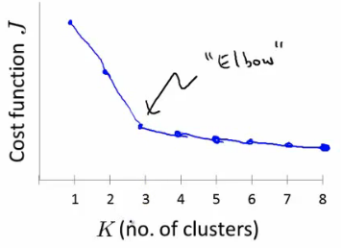
K-means algorithm
Randomly select cluster centroids
Measure the distance between each example and the cluster centroids
Assign the nearest cluster to each example
Calculate the mean of each cluster; replace cluster centroids with corresponding cluster means and repeat assigning each example with it’s nearest cluster
Repeat till clusters no longer change; optimum total variation for each cluster
How to find best value for k? Measure the reduction in total variation in each cluster as k is increased, find the elbow point
Cost function J = Sum of squared distances

Slide 17
EM Algorithm
Uses Gaussians to predict the clusters of a dataset
Can be considered as soft-clusters – clusters are based on a probability and can overlap with each other
Algorithm
Pick the number of clusters k, and randomly pick mean, and variance for each
k=2, clusters a and b
For each point: P(b|x_i) = does it look like it came from b?
Use Bayes theorem to find P(b|x_i) where P(x_i|b) is the gaussian probability
P(a|x_i) = 1- P(b|x_i)
Readjust mean and variance for a and b to fit points assigned to them
Unlike k-means, probability is used instead of hard assignment
Repeat process until it converges

Slide 18
Break – 5 mins

Slide 19
Exercise time – 45 mins
Use the boston.csv dataset provided and do
EDA
Predict Median Value of homes using regression, DT, RF and GBM
Use Cross validation and grid search for hyper parameter tuning

